Slide 1
Generalized Optimal Linear Orders
M.S. Thesis
Rishi Bommasani
Cornell University
Notes:
Thanks to everyone for showing up! To begin, I want to quickly bring up the logistics of question-asking. If you have a question: 1. Unmute yourself and interrupt me. I likely won’t pay attention to hand-raising/the chat, so if someone sees another person trying to ask a question, feel free to chime in 2. I will intermittently pause to give time for questions. 3. Questions can be asked at the end of the talk.

Slide 2
Motivation
Notes:
I want to begin by framing this work by some overarching lofty goals.

Slide 3
Goals:
Unified theory for linear word order
Improved downstream NLP systems
Notes:
We want to work towards a more complete understanding of word order; drawing upon inspiration from cognitive science, algorithms, and psycholinguistics.
We then want to understand if and how this might find application in creating more performant NLP systems.

Slide 4
Human representations are not machine-optimal
language, gestures, mathematics, visual communication vs. bits
Human representations in language are not machine-optimal
characters, words, sentences vs. numbers, vectors, linear transformations
Notes:
We are well-accustomed to the fact that we specify aspects of human life and human-human interaction in drastically different ways within machines.
Bullet point 1 This can be seen within the context of language. Bullet point 2.

Slide 5
Word order is a fundamental property of language
Word order is (generally) how we convey syntax
We are pretty good at a broad class of lexical/word-level representation learning
Combinatorial space of possibilities
Tremendously unexplored in NLP; O(1) orders normally considered
Natural algorithmic challenges for exploring insightfully
Notes:
Given this priming, I will consider word order as a core property of natural language and the representational choices one may consider in NLP. From a scientific standpoint: Don’t pass parse trees – Bullet 1 The gap between sentence level and word level representation learning – Bullet 2
From a research standpoint: Space for exploration – Bullet 3 As in many other domains, insightful exploration of this exponentially-sized space is required – Bullet 4

Slide 6
Primitives
Notes:
Pause for questions

Slide 7
Unit of analysis: sentence
Representation: sequence of words
Assumption: gold-standard tokenization
Claire teaches exciting classes.
w₁ = Claire
w₂ = teaches
w₃ = exciting
w₄ = classes
w₅ = .

Slide 8
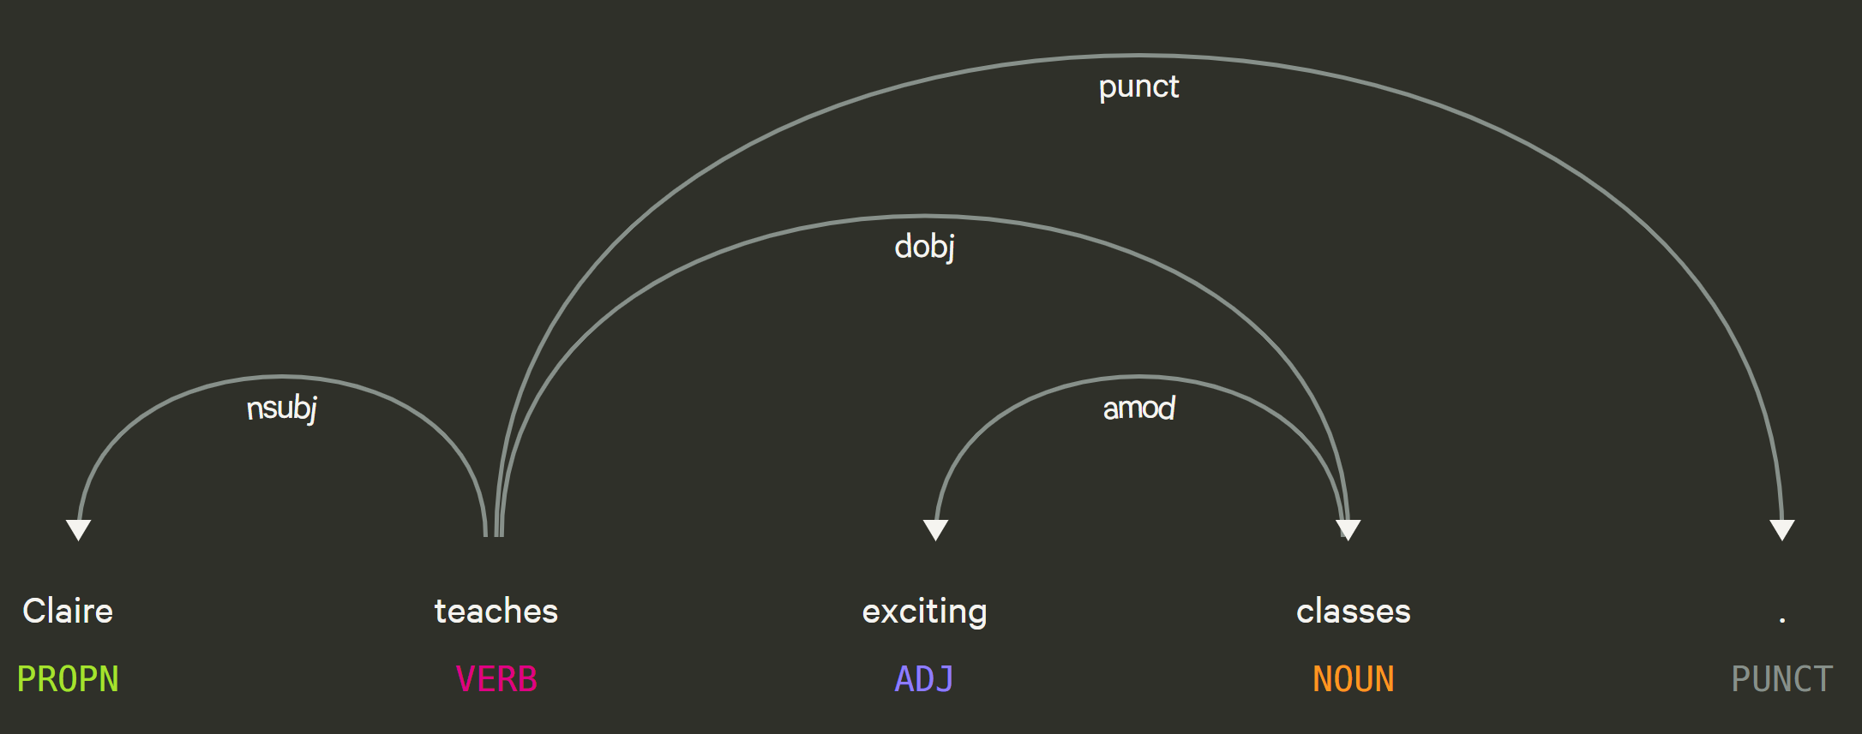

Scaffold: dependency parse
Representation: Graph G = (V, E)
$V=\left\{w_{i} | i ∈[n]\right\}\text{,}$ E = {directed, labelled binary dependency relations}

Slide 9
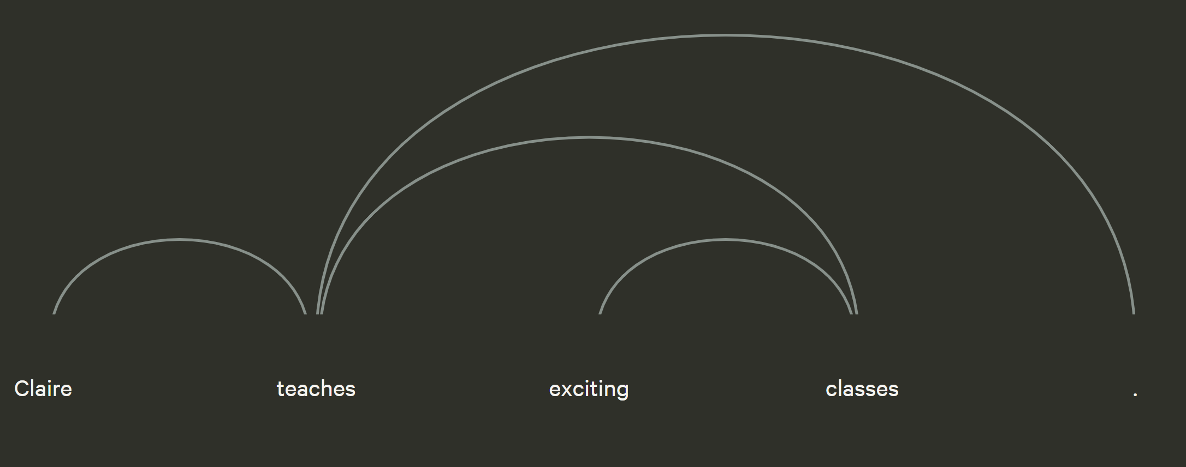

Scaffold: dependency parse
Representation: Graph G = (V, E)
$V=\left\{w_{i} | i ∈[n]\right\}$, E = {directed, labelled binary dependency relations}

Slide 10

Requirement: dependency parser
Assumption / Limitation: High-quality dependency parser
Dependency parsing: sentence $→$ dependency parse
w₁ = Claire
w₂ = teaches
w₃ = exciting
w₄ = classes
w₅ = .

Slide 11
Property: projectivity
We will draw dependency parses is this canonical way (all edges above sentences)
Projective: The parse has no intersecting/crossing edges when drawn this way
Common property of interest in dependency parsing, well-studied linguistically

Slide 12
Word Order and Human Language
Notes:
Pause for questions

Slide 13
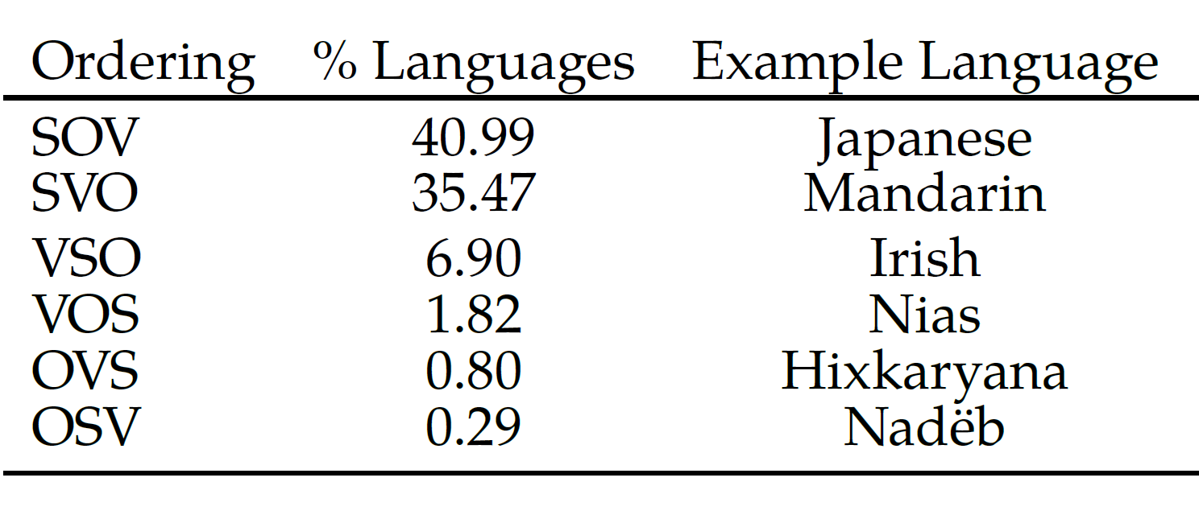
Word ordering behaviors
Rigid (Fixed) vs. Flexible (Free)
Basic word order
Why does this matter?
Language universals (Greenberg, 1963)
Harmonic orders facilitate learning (Culbertson and Newport, 2015, 2017)
Typological categorization of natural languages (Dryer, 1997)
WALS (Dryer, 2013)

Slide 14
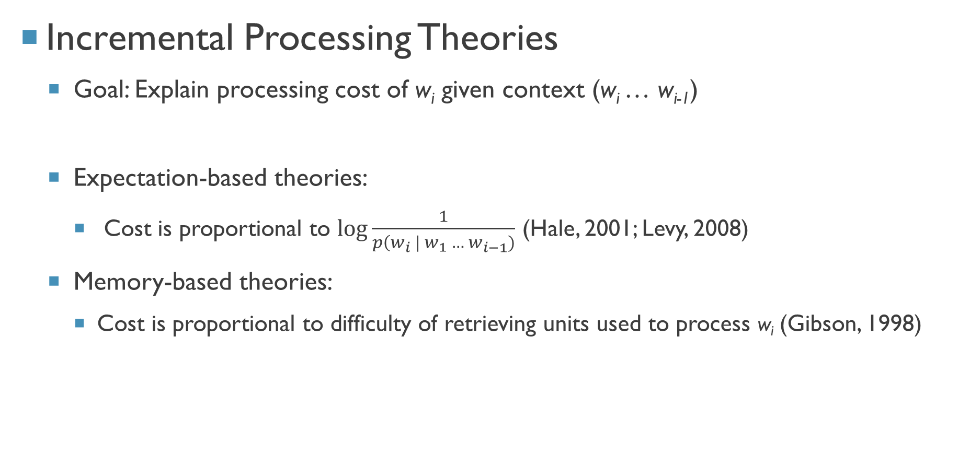
Incremental Processing Theories
Goal: Explain processing cost of w_{i} given context (w_{i} … w_{i-1})
Expectation-based theories:
Cost is proportional to $\log{\frac{1}{p\left(w_{i} \right| w_{1} … w_{i−1})}}$ (Hale, 2001; Levy, 2008)
Memory-based theories:
Cost is proportional to difficulty of retrieving units used to process w_{i} (Gibson, 1998)

Slide 15
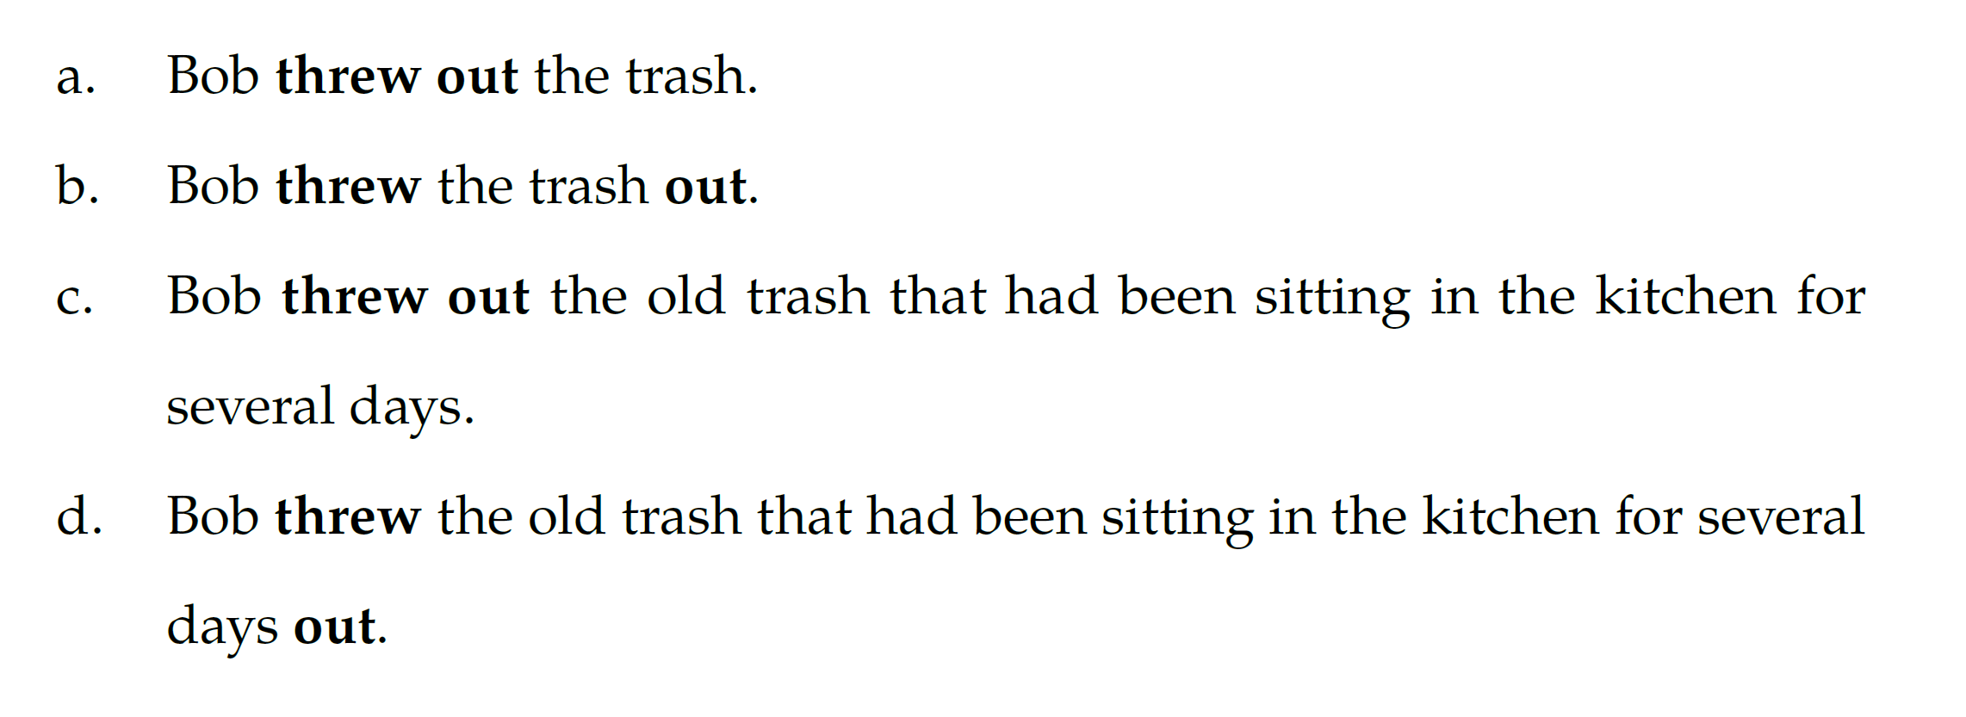
Dependency Length Minimization
What belongs together mentally is placed together (Behaghel, 1932)
Pervasive evidence:
Japanese – (Yamashita and Chang 2001); 37 natural languages – (Futrell et al. 2015)
Grammar design (Rijkhoff, 1990; Hawkins, 1990)
Beneficial inductive bias in parsing (Collins, 2003, Klein and Manning, 2004; Eisner and Smith, 2005; Smith and Eisner, 2006)

Slide 16
Algorithmic Framework
Part I: Notation and Objectives
Notes:
Pause for questions

Slide 17
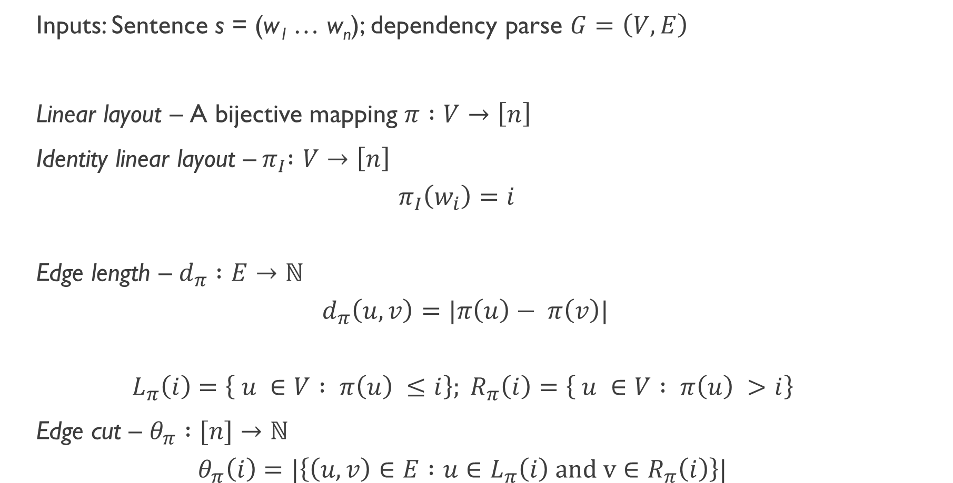
Inputs: Sentence s = (w₁ … w_{n}); dependency parse $G=\left(V,E\right)$
Linear layout – A bijective mapping $π :V→\left[n\right]$
Identity linear layout –${ π}_{I} :V→\left[n\right]$
$$π_{I}\left(w_{i}\right)=i$$
Edge length – $d_{π} :E→ℕ$
$$d_{π}\left(u,v\right)=|π\left(u\right)− π\left(v\right)|$$
$$L_{π}\left(i\right)=\left\{ u ∈V : π\left(u\right) ≤i\right\}; R_{π}\left(i\right)=\left\{ u ∈V : π\left(u\right) >i\right\}$$
Edge cut – $θ_{π} :[n]→ℕ$
$$θ_{π}\left(i\right)=|\left\{\left(u,v\right)∈E :u∈L_{π}\left(i\right) and v∈R_{π}\left(i\right)\right\}|$$

Slide 18
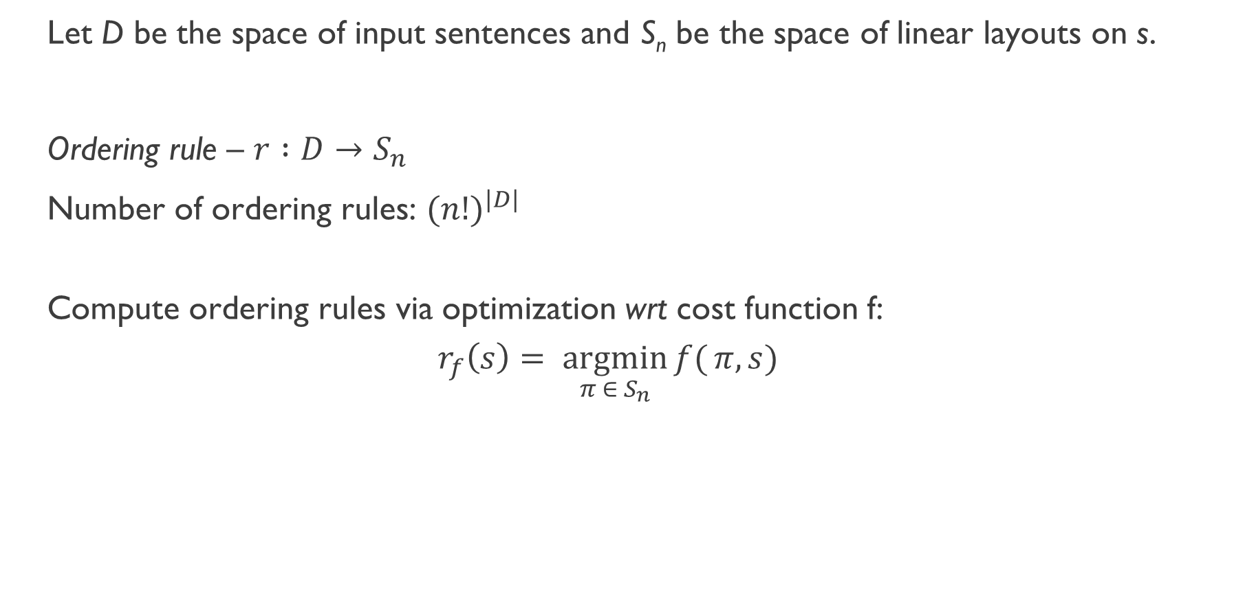
Let D be the space of input sentences and S_{n} be the space of linear layouts on s.
Ordering rule – $r :D→S_{n}$
Number of ordering rules: ${(n!)}^{|D|}$
Compute ordering rules via optimization wrt cost function f:
$$r_{f}\left(s\right)= \underset{{π ∈ S}_{n}}{argmin}{f(}π, s)$$

Slide 19
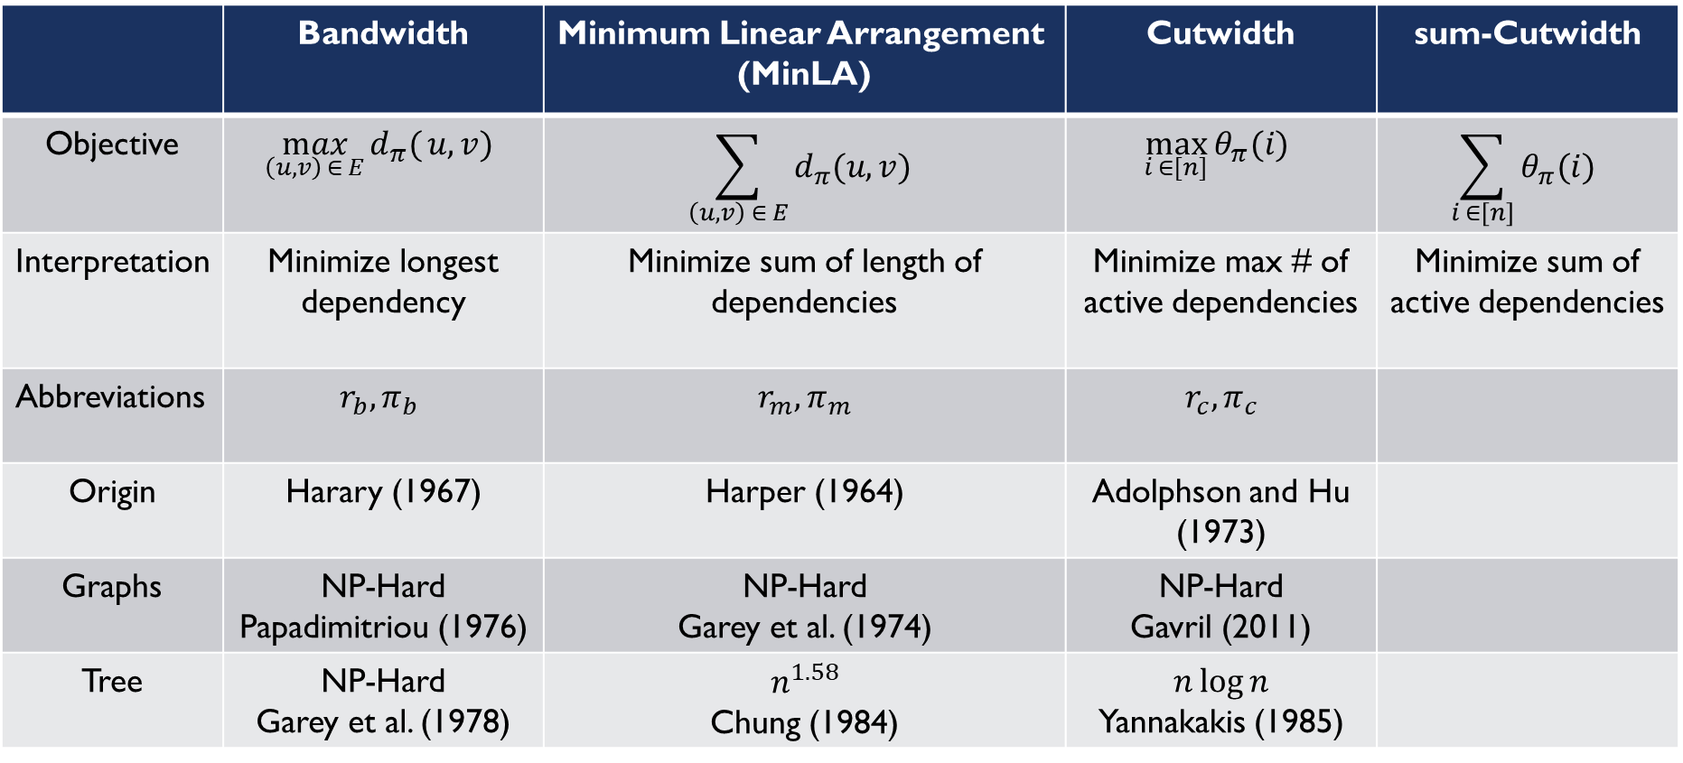
 | Bandwidth | Minimum Linear Arrangement (MinLA) | Cutwidth | sum-Cutwidth
Objective | $$\max_{\left(u,v\right) ∈ E}{d_{π}(}u, v)$$ | $$\sum_{\left(u,v\right) ∈ E}{d_{π}(u, v)}$$ | $$\max_{i ∈[n]}{θ_{π}(i)}$$ | $$\sum_{i ∈[n]}{θ_{π}(i)}$$
Interpretation | Minimize longest dependency | Minimize sum of length of dependencies | Minimize max # of active dependencies | Minimize sum of active dependencies
Abbreviations | $$r_{b}, π_{b}$$ | $$r_{m}, π_{m}$$ | $$r_{c}, π_{c}$$
Origin | Harary (1967) | Harper (1964) | Adolphson and Hu (1973)
Graphs | NP-Hard Papadimitriou (1976) | NP-Hard Garey et al. (1974) | NP-Hard Gavril (2011)
Tree | NP-Hard Garey et al. (1978) | $$n^{1.58}$$ Chung (1984) | $$n\log{n}$$ Yannakakis (1985)

Slide 20
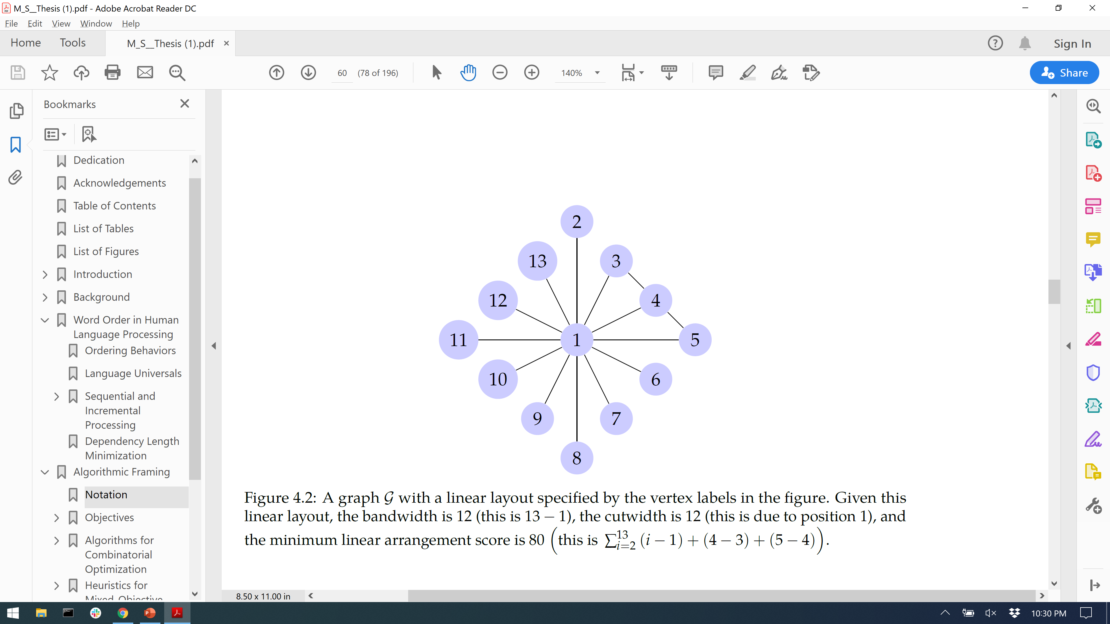

Slide 21
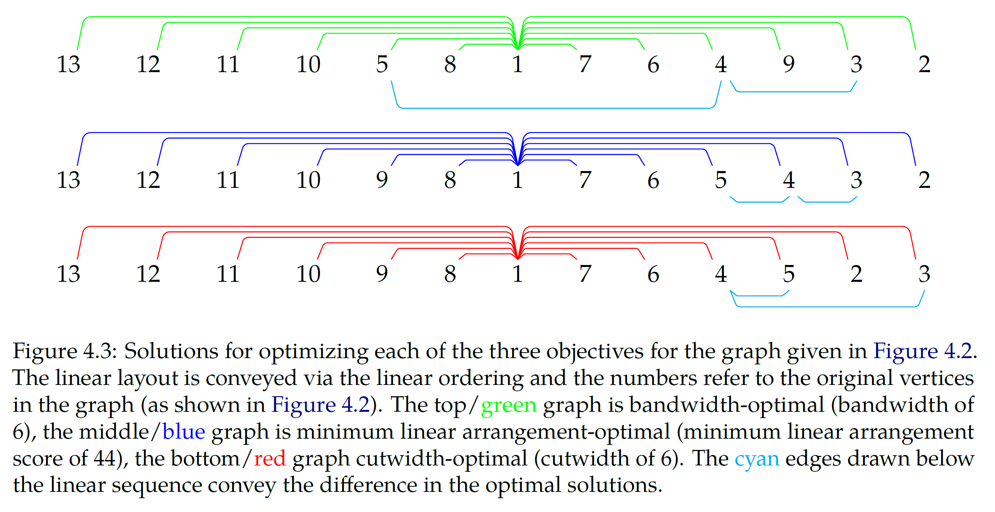
Bandwidth
MinLA
Cutwidth

Slide 22
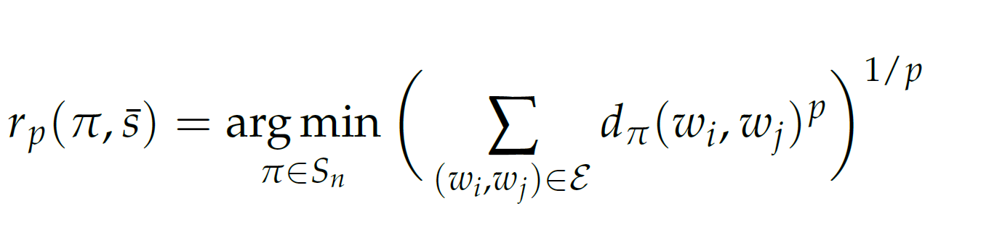
Generalizing Bandwidth and MinLA
Equating MinLA and sum-Cutwidth
MinLA : Each edge contributes it length
sum-Cutwidth: Each edge contributes 1 to every position from its left endpoint up until its right endpoint.

Slide 23
Algorithmic Framework
Part II: Algorithms
Notes:
Pause for questions

Slide 24
Bandwidth
Heuristic from Cuthill and McKee (1969); modified by Chan and George, 1980
Breadth-first search in order of increasing degree
MinLA
Linear time under projectivity constraints* from Gildea and Temperley, 2007
Will correct some errors and show it uses the same ideas as Yannakakis, 1985
Cutwidth
Linear time under projectivity constraints* from Yannakakis, 1985
Dynamic programming over tree structure known as disjoint strategy
* In the algorithms community, this is sometimes referred to the PLANAR version of the problem (e.g. PLANAR-CUTWIDTH)

Slide 25
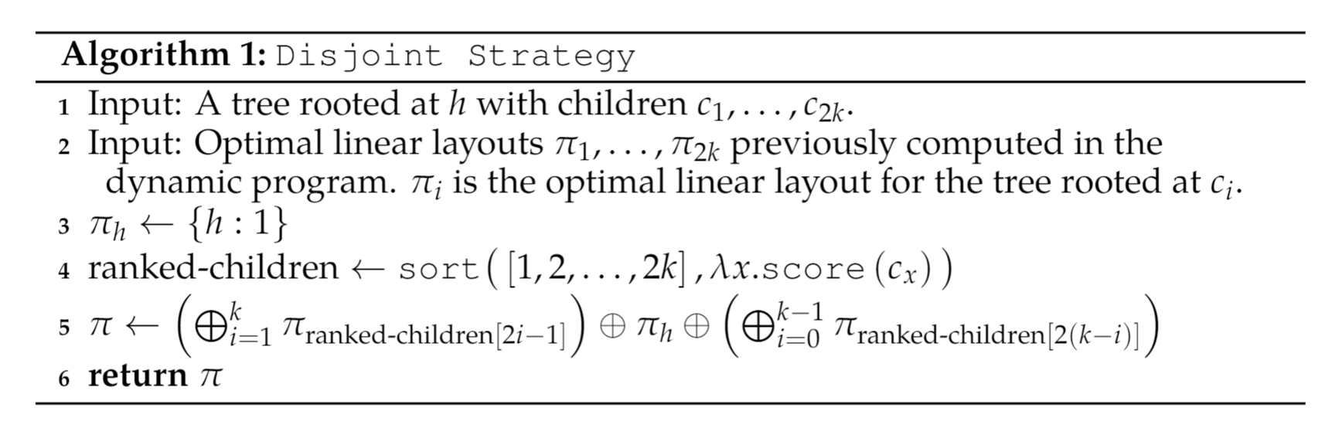
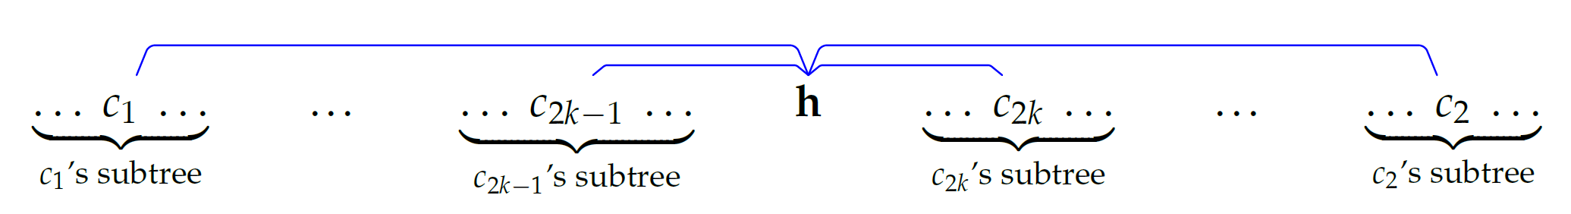

Slide 26
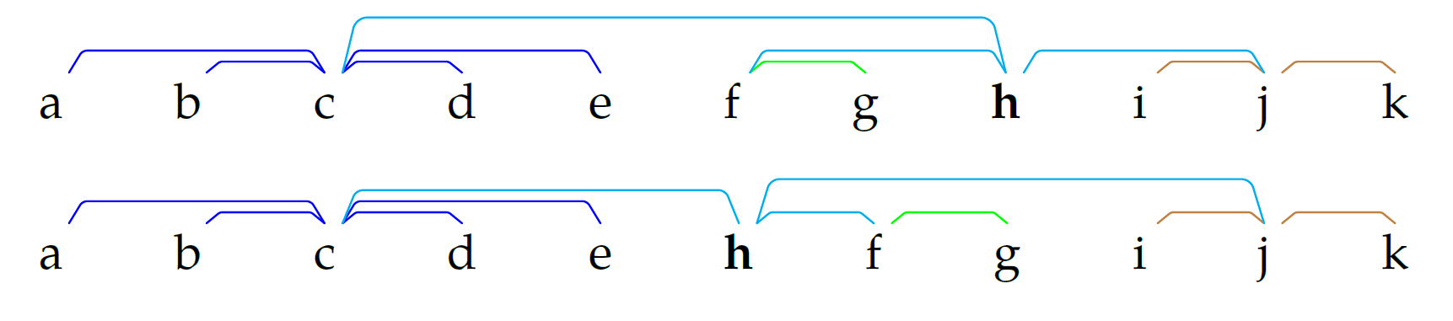
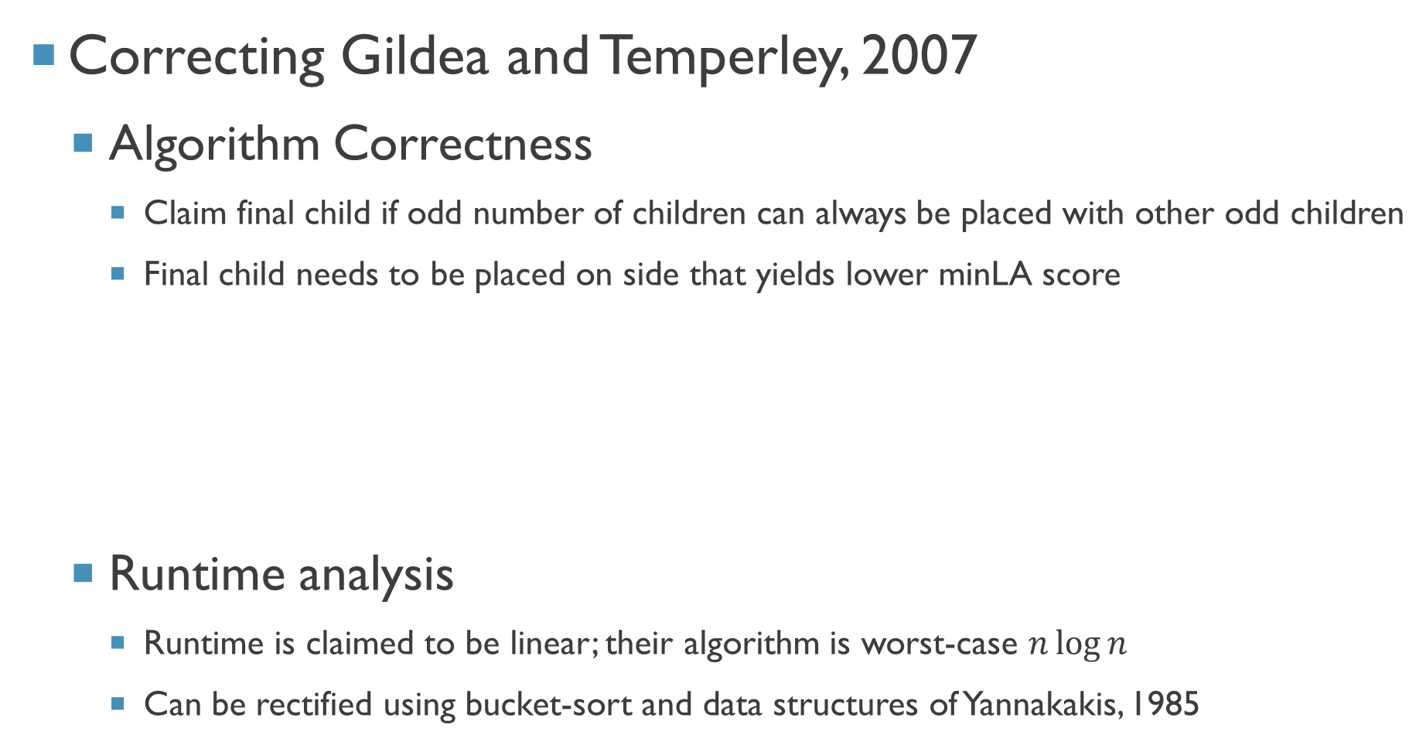
Correcting Gildea and Temperley, 2007
Algorithm Correctness
Claim final child if odd number of children can always be placed with other odd children
Final child needs to be placed on side that yields lower minLA score
Runtime analysis
Runtime is claimed to be linear; their algorithm is worst-case $n\log{n}$
Can be rectified using bucket-sort and data structures of Yannakakis, 1985
G & T, 2007
Ours
Notes:
Note the positions of the subtrees rooted at c and j are the same, the difference is the subtree rooted at f

Slide 27
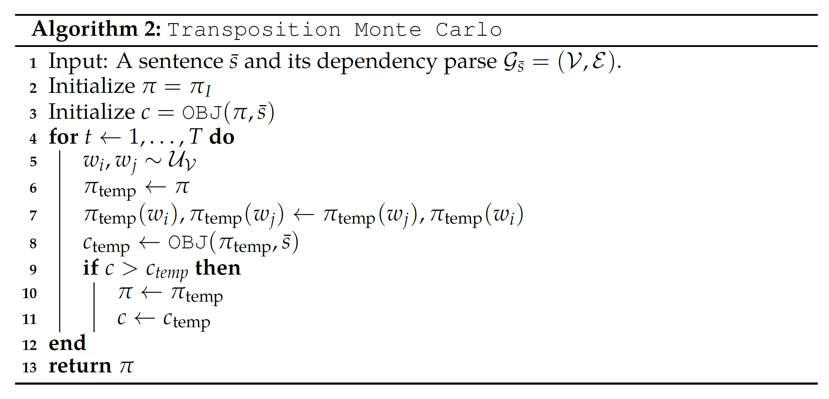
Additional Heuristics
T is a parameter for balancing between retaining the standard word order and optimizing the objective function.
Small T – Similar to natural language, Large T – Locally optimal for objective
Notes:
Pause for questions

Slide 28
Integrating Novel Orders with NLP
Part I: Methods

Slide 29
Order-Agnostic Methods
Word embeddings, topic models, bag-of-words text classifiers
Sentence encoders: DANs (Iyyer et al., 2015), SIF (Arora et al., 2017)
Sequential Models
HMMs, MEMMs, CRFs
RNNs, LSTMs, GRUs, SRUs
Position-Aware Methods
Transformers (Vaswani et al., 2017)
Encode (w₁ … w_{n}) as {(w₁, 1), …, (w_{n}, n)} (Vinyals et al., 2016)

Slide 30
Alternative word orders
Bidirectional models - (w₁ … w_{n}) and (w_{n} … w₁)
Permutation models – XLNet (Yang et al., 2019)
Alignment
Attention (Bahdanau et al., 2015; Luong et al., 2015)
Preorders – Reorder source language to mimic target language order
Postorders – Reordering monotone translation to mimic target language order

Slide 31
Integrating Novel Orders
Train models on permuted sentences instead of standard sentences
Surprisingly effective in initial experiments; does not leverage pretraining
Input permuted sentences into standard pretrained encoders
Unsurprisingly, does not work
Pretrain on permuted sentences
Not feasible, unclear if pretraining objects (e.g. language modelling) even make sense

Slide 32
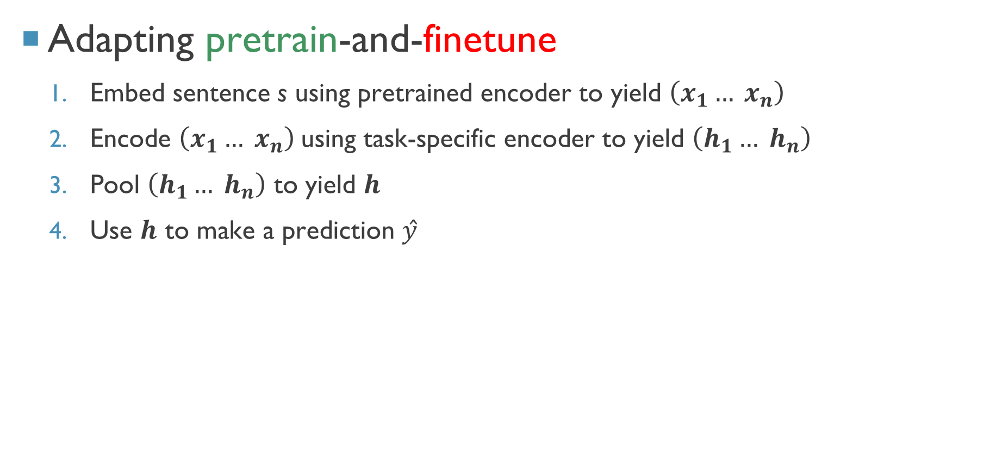
Adapting pretrain-and-finetune
Embed sentence s using pretrained encoder to yield $\left(x_{1}… x_{n}\right)$
Encode $\left(x_{1}… x_{n}\right)$using task-specific encoder to yield $\left(h_{1}… h_{n}\right)$
Pool $\left(h_{1}… h_{n}\right)$ to yield $h$
Use $h$ to make a prediction $ŷ$

Slide 33
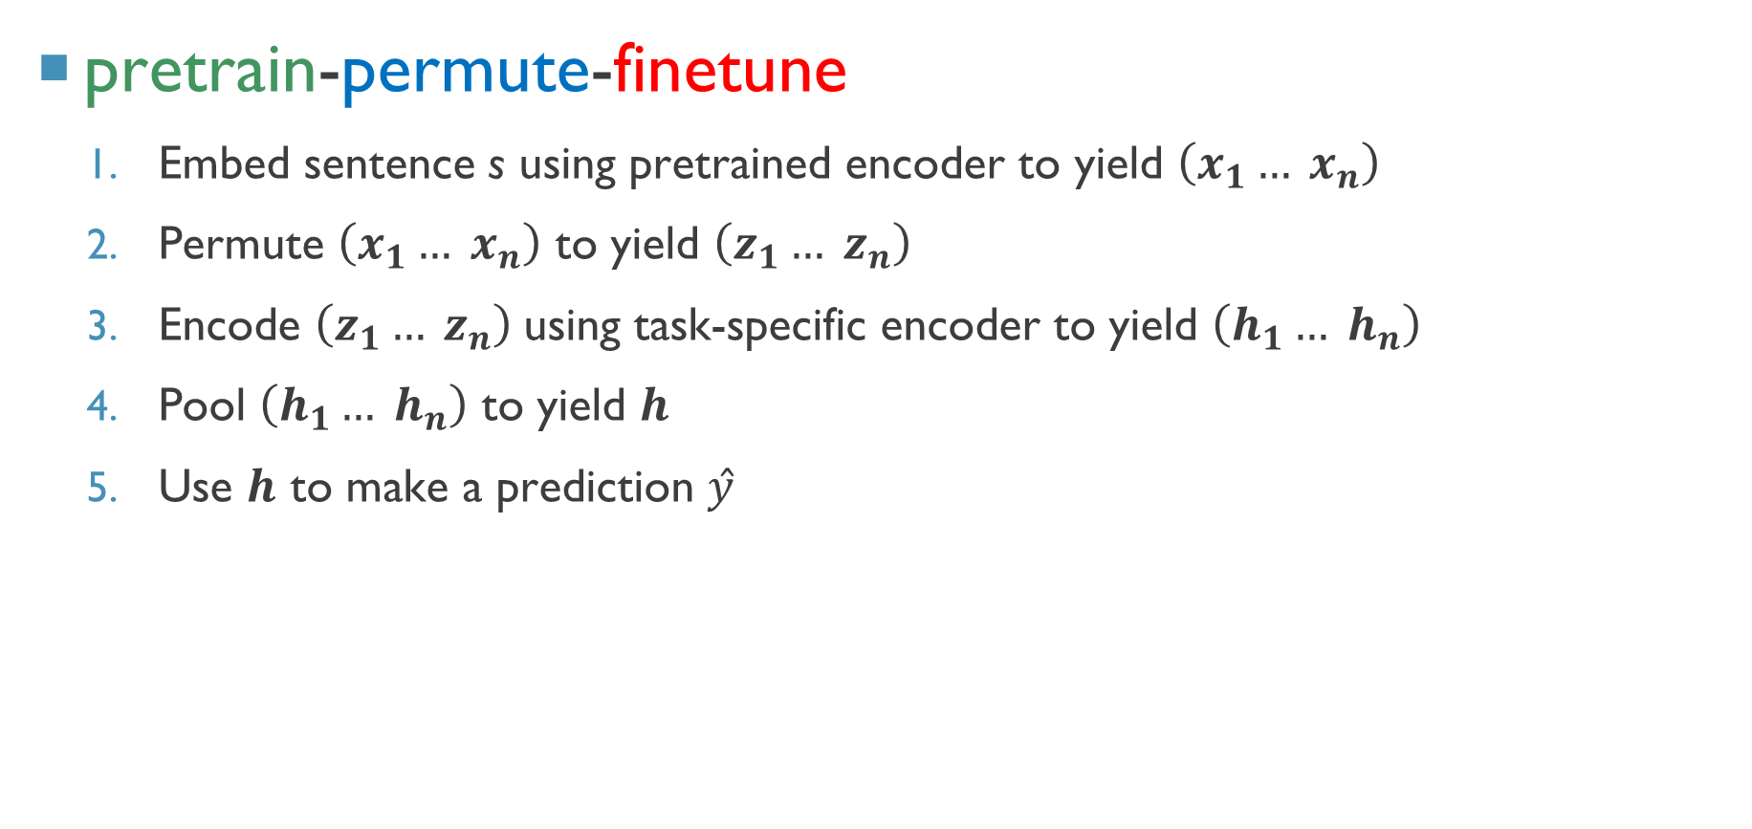
pretrain-permute-finetune
Embed sentence s using pretrained encoder to yield $\left(x_{1}… x_{n}\right)$
Permute $\left(x_{1}… x_{n}\right)$ to yield $\left(z_{1}… z_{n}\right)$
Encode $\left(z_{1}… z_{n}\right)$using task-specific encoder to yield $\left(h_{1}… h_{n}\right)$
Pool $\left(h_{1}… h_{n}\right)$ to yield $h$
Use $h$ to make a prediction $ŷ$
Permute
Notes:
Key difference is the permute step in 2

Slide 34
Integrating Novel Orders with NLP
Part II: Experimental Setup

Slide 35
Model
spaCy dependency parser, frozen ELMo pretrained representations
Bidirectional LSTM task-specific encoder with max-pooling and linear classifer
Cross-Entropy Loss, Adam Optimizer, Dropout
Train for 12 epochs (very similar to various early-stopping conditions)
Mini-batch size of 16
Aforementioned hyperparameters optimized for baselines
Other hyperparameters (hidden size, dropout parameter) are independently optimized for every baseline/model we are considering.

Slide 36
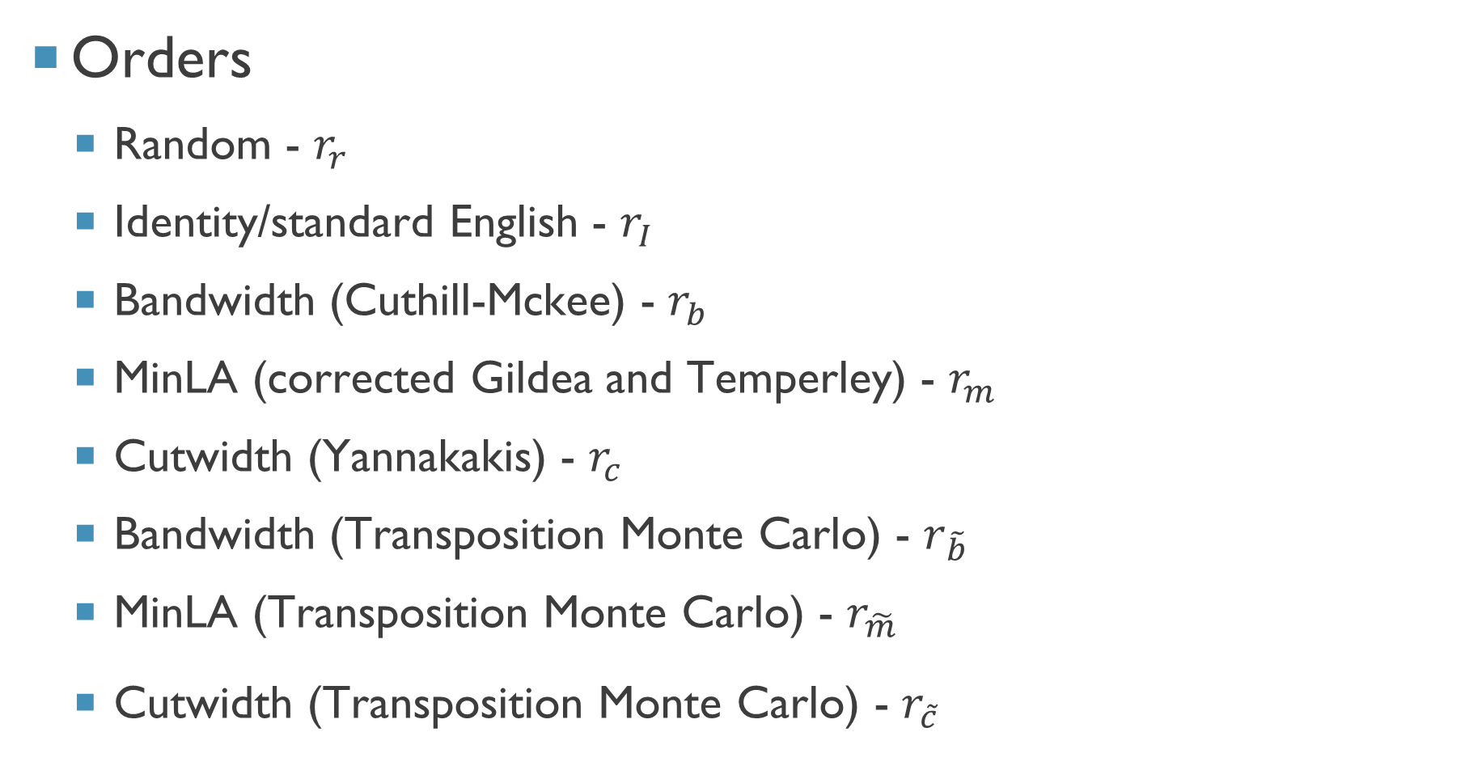
Orders
Random - $r_{r}$
Identity/standard English - $r_{I}$
Bandwidth (Cuthill-Mckee) - $r_{b}$
MinLA (corrected Gildea and Temperley) - $r_{m}$
Cutwidth (Yannakakis) - $r_{c}$
Bandwidth (Transposition Monte Carlo) - $r_{\tilde{b}}$
MinLA (Transposition Monte Carlo) - $r_{\tilde{m}}$
Cutwidth (Transposition Monte Carlo) - $r_{\tilde{c}}$

Slide 37
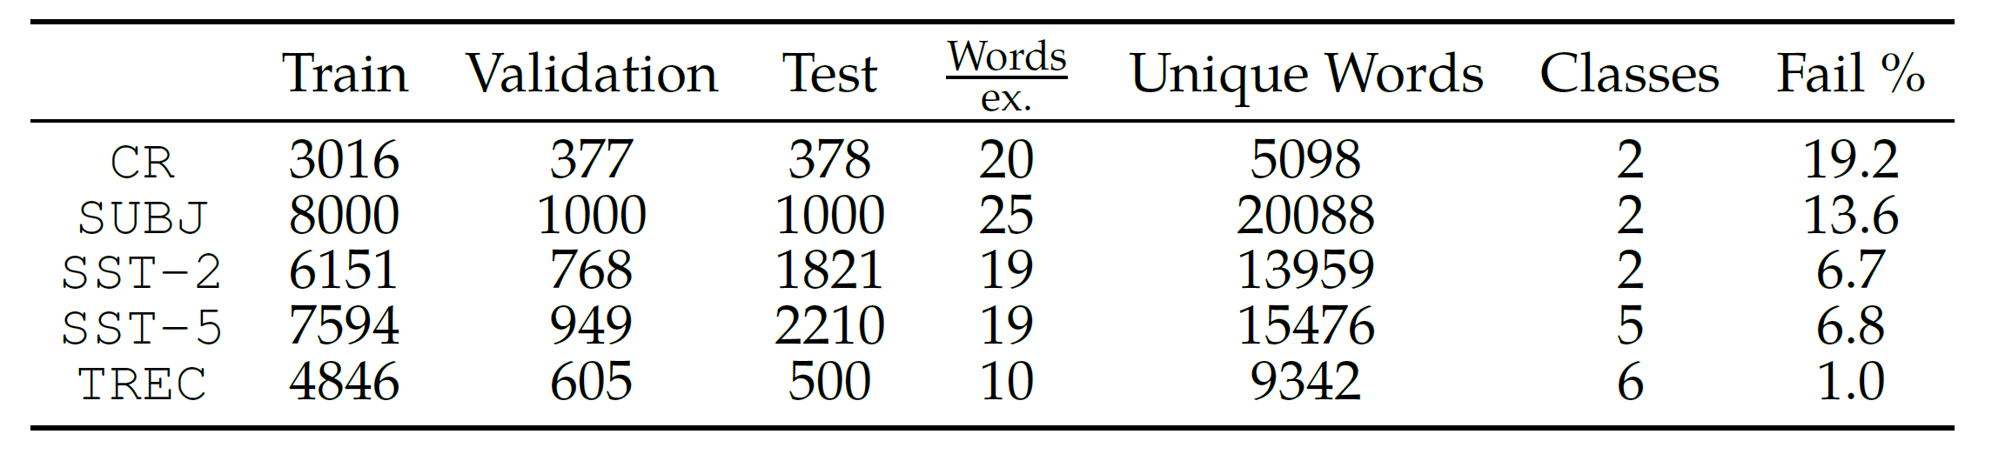
Datasets – English Language Text Classification
CR : Sentiment analysis for customer reviews (Hu and Liu, 2004)
SUBJ : Subjectivity analysis for movie data (Pang and Lee, 2004)
SST-2 : Sentiment analysis for movie reviews (Pang and Lee, 2005; Socher et al., 2013)
SST-5 : Fine-grained sentiment analysis for movie reviews (Pang and Lee, 2005; Socher et al., 2013)
TREC : Question classification (Li and Roth, 2002)

Slide 38
Integrating Novel Orders with NLP
Part III: Results and Analysis
Notes:
Pause for questions

Slide 39
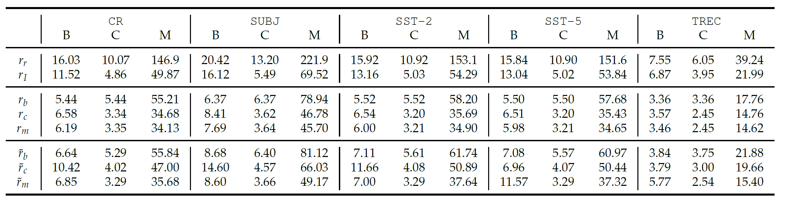
Optimization Results
English substantially more optimal than random for (dataset, objective) pairs
Substantial margin for all objectives to improve over English
Algorithms from literature outperform our algorithms
Gildea and Temperley, Yannakakis achieve similar results for all objectives
Greedy optimization in Transposition Monte Carlo seems to work best for MinLA

Slide 40
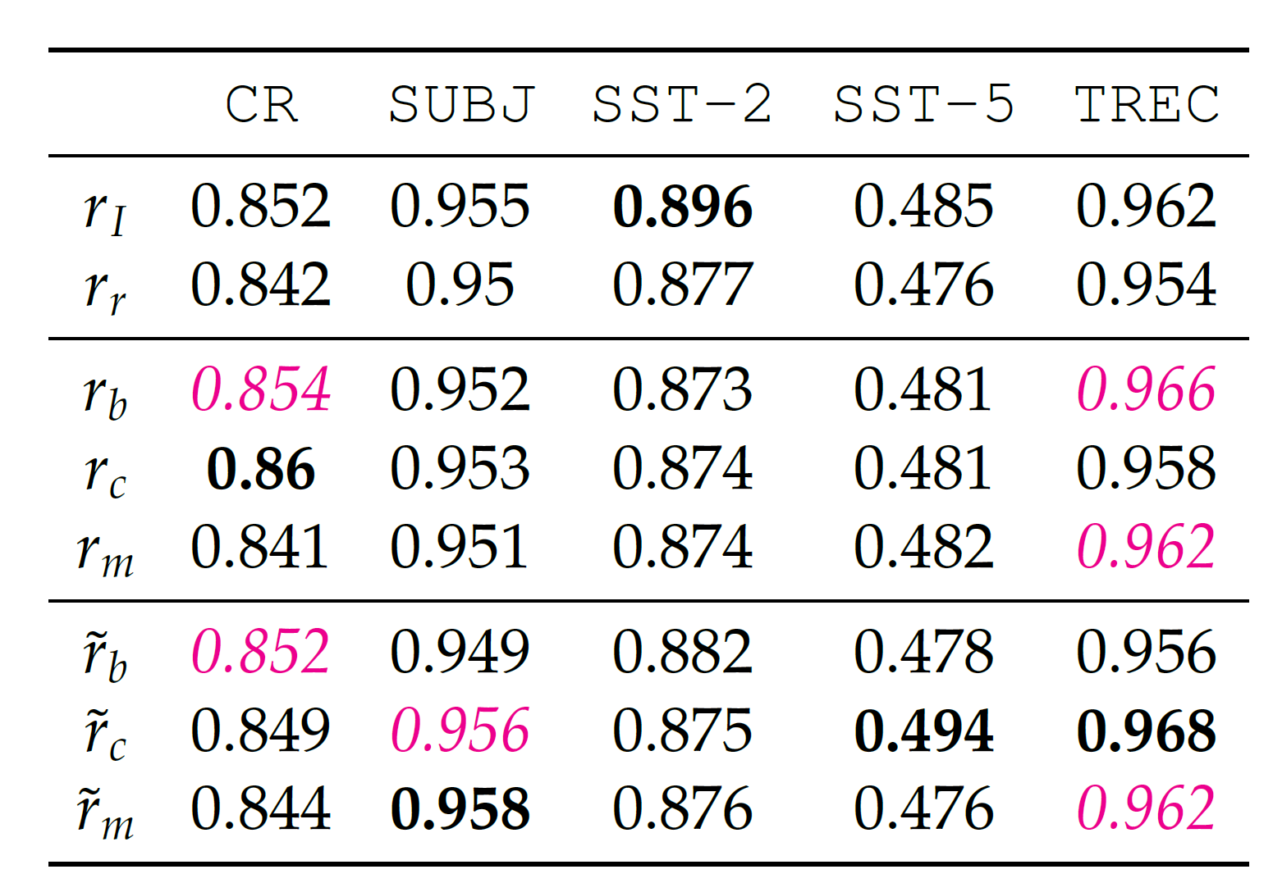
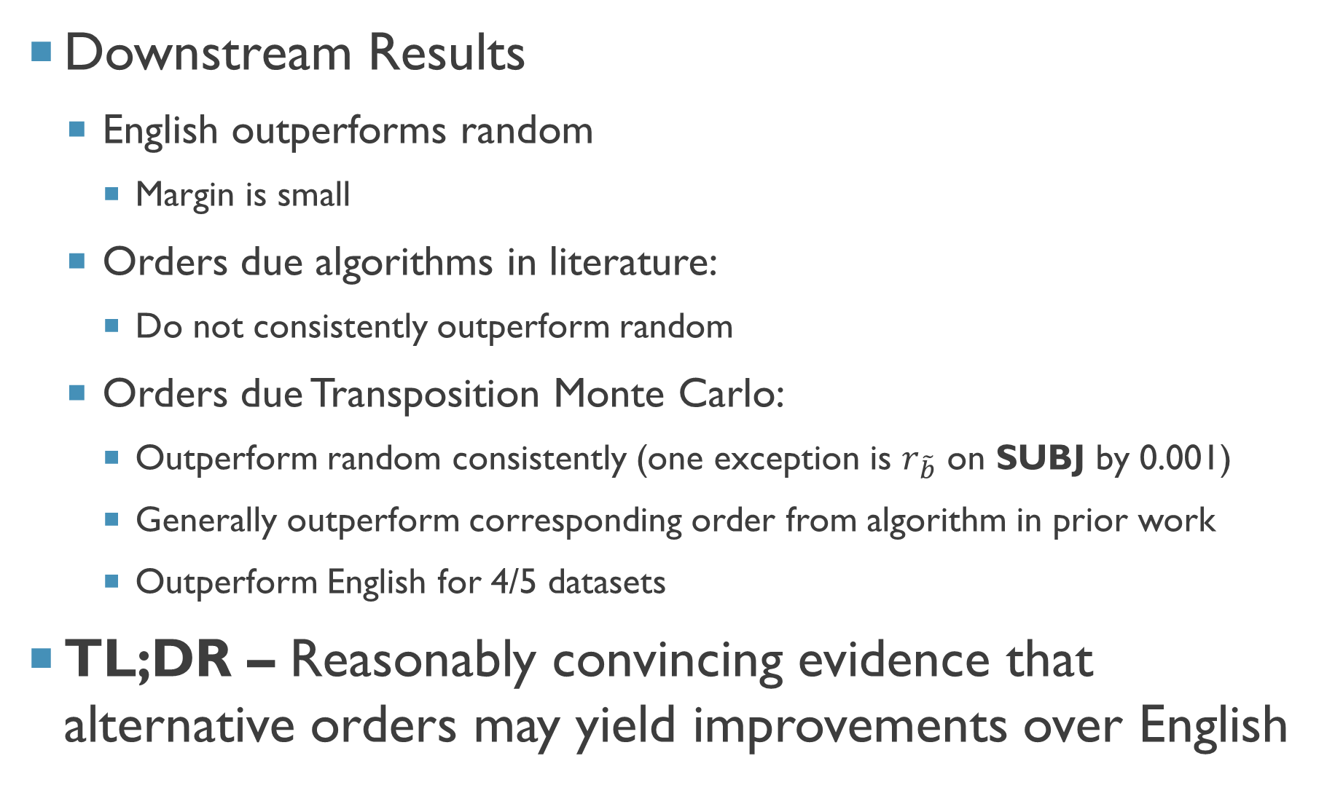
Downstream Results
English outperforms random
Margin is small
Orders due algorithms in literature:
Do not consistently outperform random
Orders due Transposition Monte Carlo:
Outperform random consistently (one exception is $r_{\tilde{b}}$ on SUBJ by 0.001)
Generally outperform corresponding order from algorithm in prior work
Outperform English for 4/5 datasets
TL;DR – Reasonably convincing evidence that alternative orders may yield improvements over English

Slide 41
Outcomes
Part I: Contributions
Notes:
Pause for questions

Slide 42
Unifying treatments of linear order
Algorithmic reframing of prior psycholinguistic work
Extending set of orders considered in NLP in sequential models
Considering alternative orders in NLP
Introduced pretrain-permute-finetune framework
Empirical evaluation of effects on downstream NLP; resolute evidence to warrant further inquiry into alternative orders

Slide 43
Goals:
Unified theory for linear word order
Improved downstream NLP systems

Slide 44
Outcomes
Part II: Open Problems and Future Directions

Slide 45
Beyond Dependencies
Information-theoretic approaches inspired by information locality
Constituency-based orderings / alternative syntactic theories
Learned Orderings
End-to-end (differentiable) learning of orderings
Task-specific weighting (and corresponding combinatorial optimization algorithms)
Understanding
Information obfuscation due to permutation
Interplay between pretrain and permute steps
Empirical understanding of when and why this works for downstream NLP

Slide 46
Outcomes
Part III: Limitations

Slide 47
Dependence on Dependencies
Parsers in arbitrary languages cannot be assumed
Annotations/schemas do not exist for some languages (e.g. beyond UD)
Rigid Optimization
No natural way to incorporate side-information
Meaningfulness of “pure” optimization is contingent on quality of parser
Evaluation Settings
Tasks beyond sentence-level text classification; models beyond LSTMs
Languages beyond English

Slide 48

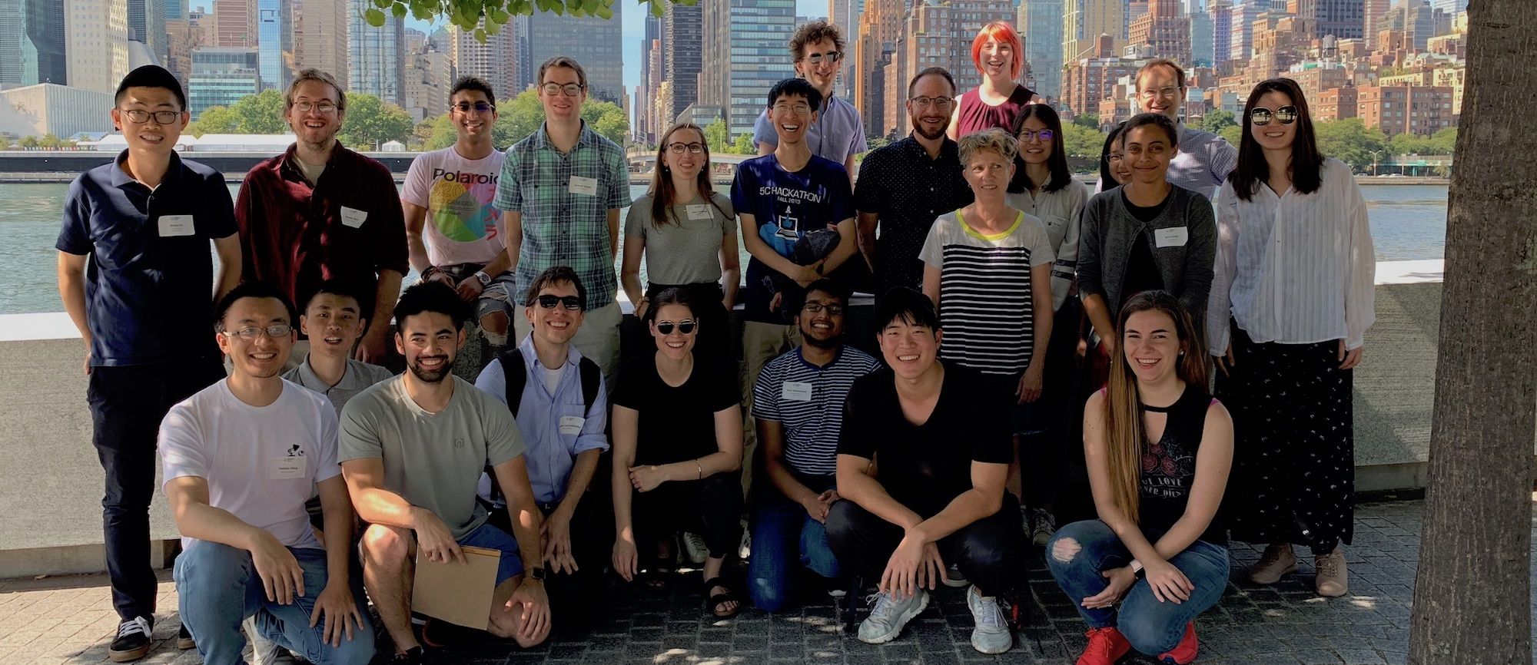
Thanks!
Claire Cardie
Bobby Kleinberg
Tianze Shi [Cornell], Marty van Schijndel [Cornell], Forrest Davis [Cornell], Lillian Lee [Cornell], John Hewitt [Stanford], Percy Liang [Stanford], Dan Klein [Berkeley], Jason Eisner [JHU], Ge Gao [Cornell], Arzoo Katiyar [Cornell], Vlad Niculae [Cornell], Kai Sun [Cornell], Tal Linzen [NYU],Tatsu Hashimoto [Stanford], Sasha Rush [Cornell], Yoav Artzi [Cornell], Nelson Liu [Stanford], Nori Kojima [Cornell], Nick Tomlin [Berkeley]
ACL SRW 2019 and NeurIPS 2019 Context and Compositionality reviewers and poster attendees
Cornell NLP Fall 2019 Retreat audience
Cornell CS and Cornell NLP

